Slide 1
Deep Neural Networks
Course 11: Recursive Neural Networks

Slide 2
Overview
How Recurrent Neural Networks Work?
Backpropagation Through Time
Long Short Term Memory
Variations of LSTM

Slide 3
Recurrent Neural Networks
Recurrent Neural networks are used in many fields, such as:
Image generation
Sound generation
Text generation
Image Captioning
Neural Machine Translation

Slide 4

Recurrent Neural Networks
Image Captioning
Image from http://cv-tricks.com/artificial-intelligence/show-attend-tell-image-captioning-explained/

Slide 5
Recurrent Neural Networks
Music Generation
https://youtu.be/A2gyidoFsoI?t=105

Slide 6
Recursive Neural Networks
How Recurrent Neural Networks Work?

Slide 7
How Recurrent Neural Networks Work?
In a traditional neural network we assume all inputs are independent from one another
The idea of recurrent neural networks is to make use of data that comes in sequences.
They are called recurrent because they perform the same operations on every input, which is part of a sequence
Another way to think of RNN is that they have memory that summarize what has been computed so far

Slide 8

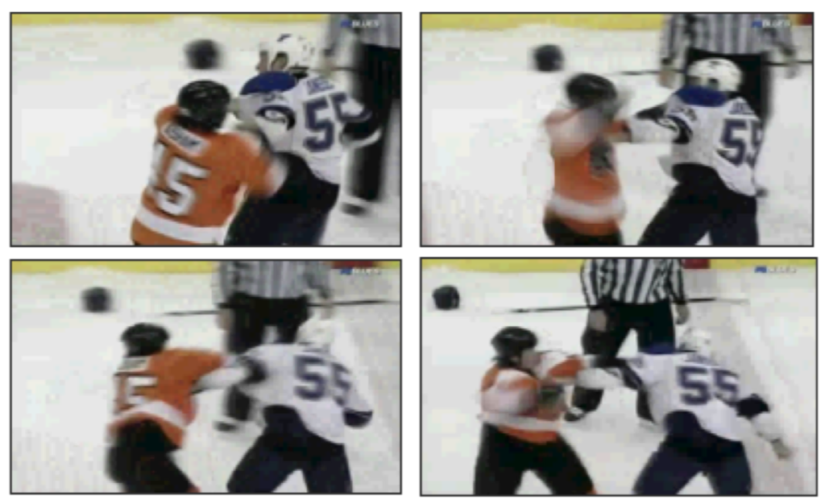
How Recurrent Neural Networks Work?
There is many data that comes into sequences:
Sound (voice, music)
DNA Sequences : ATGAATGATGATGCATCATGT…
Sentences : (sequence of words, or sequence of characters):
Videos (i.e. detecting violence)

Slide 9
How Recurrent Neural Networks Work?
While a single element in a traditional neural network will look as a set of features (i.e. a vector x), when working with sequences we need to see them as two dimensional:
(nr_seq, n ).
Example:
an image has the shape: (3, W, H). A batch of images has the shape: (B, 3, W, H)
A video has the shape (S, 3, W, H). A batch of videos has the shape (B, S, 3, W, H).
A video element has the same shape as a batch of images. The difference is when training using sequences is that we want to find information from the sequence as well. When training a batch of images we see each image separately

Slide 10
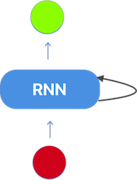
How Recurrent Neural Networks Work?
As with ANN or ML, the recurrent neural network can be viewed as having 3 layers:
Input
Hidden: in RNN this is called the state.
Output
The main difference is that the hidden layer (the state) changes w.r.t the input and the previous hidden state
Images from https://ayearofai.com

Slide 11
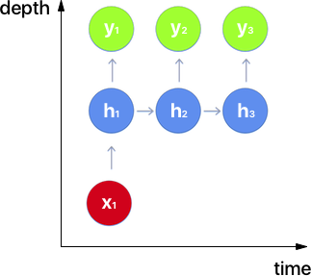
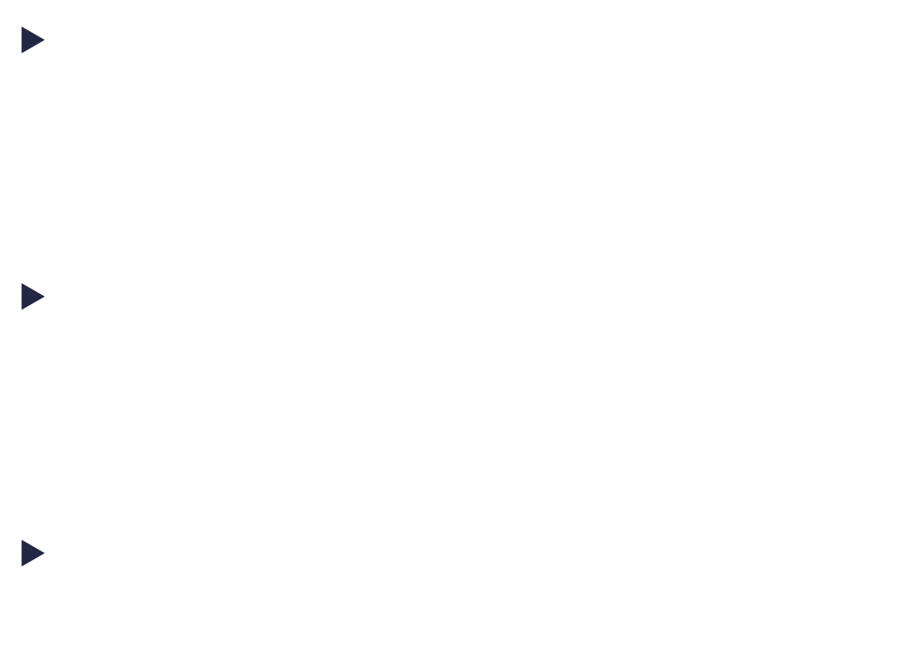
How Recurrent Neural Networks Work?
As MLP, RNN work with vectors. So, the input, the hidden state and the outputs are vectors (even though they’re represented as circles)
Since the neural network changes in time (due to changes to the state), we can say that a RNN has two dimensions: depth and time
$y_{i}, x_{i}, and h_{i}$ are the same elements but at different time steps
Images from https://ayearofai.com
Notes:
One to One e echivalent cu o retea standat
Vb de Unrolling

Slide 12
How Recurrent Neural Networks Work?
Depending on the time of when a new input is fed into the network and when an output is analyzed there can be many types of RNN architectures:
One to Many
I.e.: Captioning an image.
Input = processed image (using conv-nets)
Output = A sentence in which each word is outputted by the network at a time step
Images from https://ayearofai.com
Notes:
One to One e echivalent cu o retea standar

Slide 13
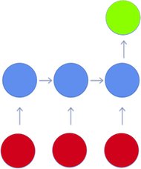
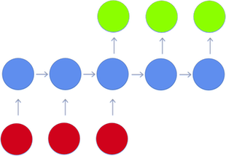
How Recurrent Neural Networks Work?
Many To one
I.e.: Sentiment classification.
Input = a sentence(sequence of words), one word per time step
Output = A sentiment (classification) after all of the words have been processed
Many To Many
I.e.: Machine translation
Input = sequence of words (sentence), one word at some time step
Output = sequence of words (sentence), one word at some time step
Images from https://ayearofai.com
Notes:
One to One e echivalent cu o retea standar

Slide 14

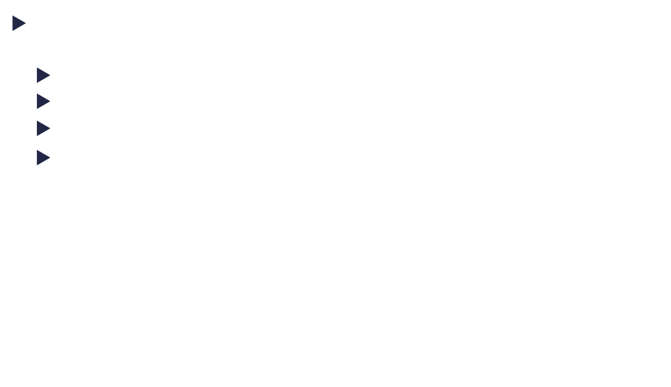





How Recurrent Neural Networks Work?
Given how the network behaves, we need to have the following set of parameters:
Input to the hidden unit: $W_{xh}$
Hidden unit to hidden unit (in time): $W_{hh}$
Hidden unit to output: $W_{hy}$
A set of biases for the hidden units and output units: $b_{h}^{}$, $b_{y}^{}$
$$h_{t}^{}=\tanh\left(W_{hh}^{}h_{t−1 }^{}+W_{xh}x_{t}+b_{h}^{}\right)$$
$$y_{t}^{}=\tanh\left(W_{hy}^{}h_{t−1 }^{}+b_{y}^{}\right)$$
Observation:
All time steps share the same weight matrix.
$$y_{t}$$
$$W_{hy}^{}$$
$$h_{t}^{}$$
$$W_{hh}^{}$$
$$W_{xh}$$
$$x_{t}$$
Notes:
One to One e echivalent cu o retea standar

Slide 15
Recursive Neural Networks
Backpropagation Through Time

Slide 16
























Backpropagation Through Time
Training an RNN is performed using Backpropagation.
However, in order to use it, we must unfold the neural network (in time). This is why the algorithms is called Backpropagation through time (BTT).
$$y_{t}$$
$$y_{t−2}$$
$$y_{t−1}$$
$$y_{t}$$
$$W_{hy}^{}$$
$$W_{hy}^{}$$
$$W_{hy}^{}$$
$$W_{hy}^{}$$
$$h_{t−2}^{}$$
$$h_{t−1}^{}$$
$$h_{t}^{}$$
$$h_{t}^{l}$$
$$W_{hh}^{l}$$
$$W_{hh}^{}$$
$$W_{hh}^{}$$
$$W_{hh}^{}$$
$$W_{xh}$$
$$W_{xh}$$
$$W_{xh}$$
$$W_{xh}$$
$$x_{t}$$
$$x_{t−2}$$
$$x_{t−1}$$
$$x_{t}$$
Notes:
BTT este de fapt un Backproapgation standard.
Aca facem unfold obtinem o retea neuronala standard, dar cu foarte multe layere

Slide 17

Backpropagation Through Time
When we have to compute the gradient w.r.t. to ${W_{hh}}_{}$ or ${W_{hx}}_{}$ we have to take into account that a modification to $W_{hx}$ or $W_{hh}$ will change the output error at every time step.
$h_{t}$ [remember: $h_{t}^{}=\tanh\left(W_{hh}^{}h_{t−1 }^{}+W_{xh}x_{t}+b_{h}^{}\right)$ ] depends on $h_{t−1}$ which depends on $W_{hh}$ and $W_{xh}$ [remember: the weights are shared]. So we can not treat it as a constant. We need to apply the chain rule all the way to the time step we’re interested in.
Notes:
O modifacre a $W_{hht}$cu o unitate va afecta functia de cost la pasul 3 in 3 ocazii diferite (E1, E2, E3)
Fiecare time-step adduce o contributie la gradient. Asa ca atunci cand calculez gradientul ar trebui sa iau in calcul fiecare cobtributie de la fiecare timestep.
E este functia de eroare. Care e totalul functiilor de eroare.
De fapt te intereseaza gradientul la timpul 3 fata de fiecare timestep, ca sa poti calcula gradientul
http://www1.idc.ac.il/toky/seminarIP-18/Presentations/11a_yaniv.pdf
Slide-ul 32/74 ajuta

Slide 18














Backpropagation Through Time
Let’s see how backpropagation thorough time would work for a single output for 3 time steps when computed for weight $W_{xh}$
$$y_{3}$$
$$W_{hy}^{}$$
$$h_{1}^{}$$
$$h_{2}^{}$$
$$h_{3}^{}$$
$$W_{hh}^{}$$
$$W_{hh}^{}$$
$$W_{xh}$$
$$W_{xh}$$
$$W_{xh}$$
$$x_{1}$$
$$x_{2}$$
$$x_{3}$$

Slide 19





Backpropagation Through Time
Let’s compute the gradient for the weight $W_{xh}$
for timestep 3:
$\frac{∂L_{3}}{∂W_{xh}}=\frac{∂L_{3}}{∂y_{3}}\frac{∂y_{3}}{∂h_{3}}\frac{∂h_{3}}{∂W_{xh}}$
$$y_{3}$$
$$W_{hy}^{}$$
$$h_{3}^{}$$
$$W_{hh}^{}$$
$$W_{xh}$$
$$x_{3}$$

Slide 20

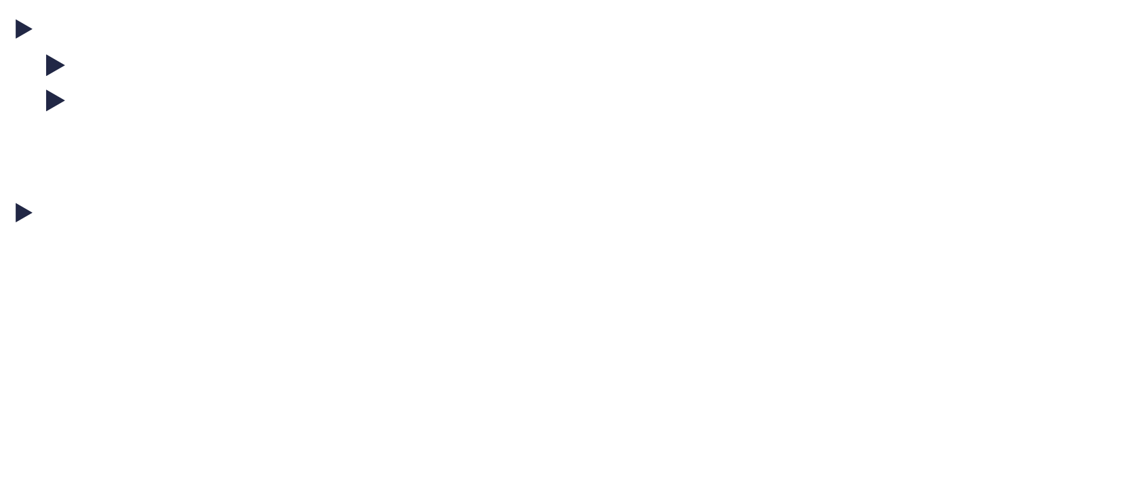








Backpropagation Through Time
When computing for multiple time steps we need to take into consideration
The output ($y_{3})$ depends also on previous inputs through $h_{t}$
that $h_{t}$ is computed based on $h_{t−1}$
Let’s compute for 2 timesteps
$\frac{∂L_{3}}{∂W_{xh}}=\frac{∂L_{3}}{∂y_{3}}\frac{∂y_{3}}{∂h_{3}}\frac{∂h_{3}}{∂W_{xh}}+$
$+\frac{∂L_{3}}{∂y_{3}}\frac{∂y_{3}}{∂h_{3}}\frac{∂h_{3}}{∂h_{2}}\frac{∂h_{2}}{∂W_{xh}}$
$$y_{3}$$
$$W_{hy}^{}$$
$$h_{2}^{}$$
$$h_{3}$$
$$W_{hh}^{}$$
$$W_{hh}^{}$$
$$W_{xh}$$
$$W_{xh}$$
$$x_{2}$$
$$x_{3}$$
Notes:
Trebuie sa ajung pana la ht-2 care a influentat rezultatul la y t-1

Slide 21


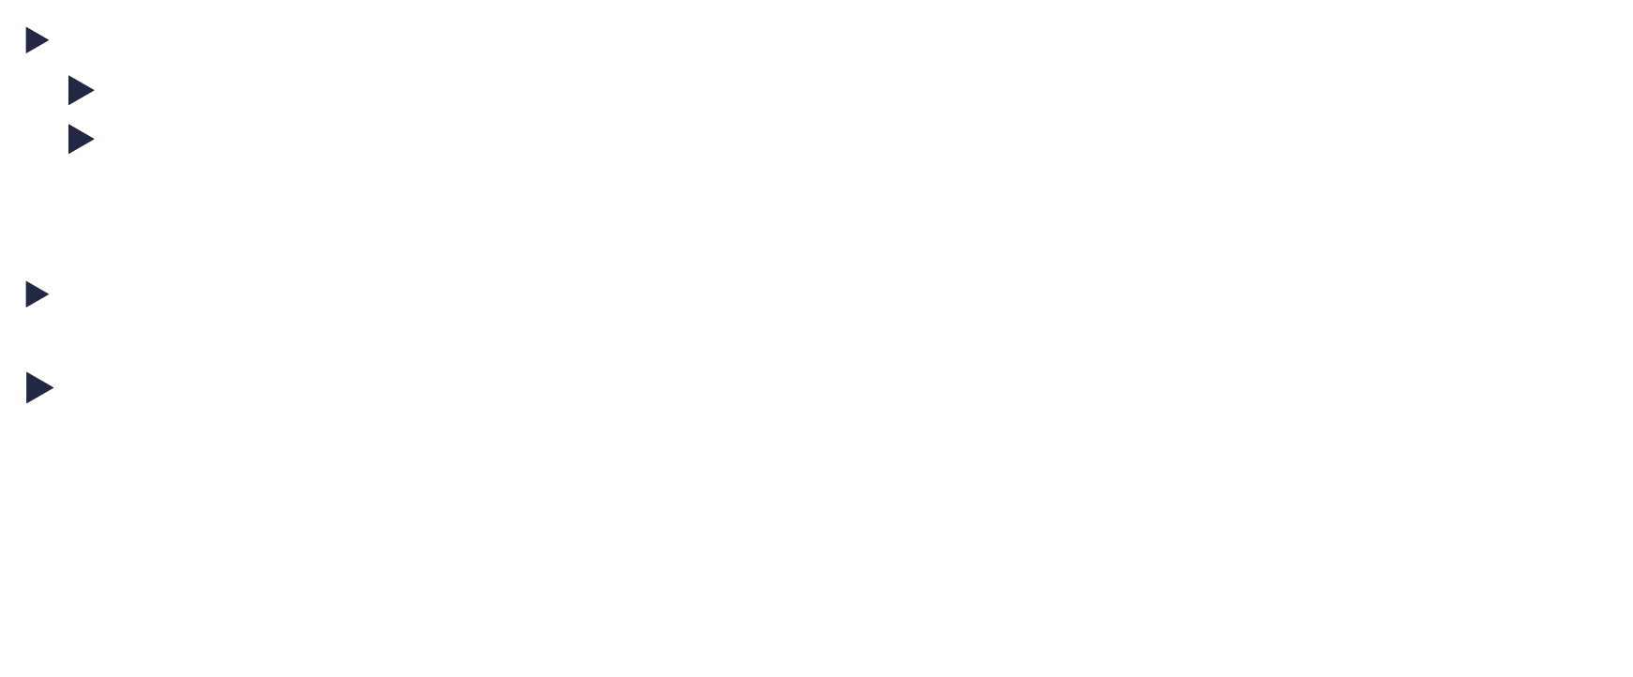











Backpropagation Through Time
When computing for multiple time steps we need to take into consideration
The output ($y_{3})$ depends also on previous inputs through $h_{t}$
that $h_{t}$ is computed based on $h_{t−1}$
Let’s compute for 3 timesteps
$\frac{∂L_{3}}{∂W_{xh}}=\frac{∂L_{3}}{∂y_{3}}\frac{∂y_{3}}{∂h_{3}}\frac{∂h_{3}}{∂W_{xh}}+$
$+\frac{∂L_{3}}{∂y_{3}}\frac{∂y_{3}}{∂h_{3}}\frac{∂h_{3}}{∂h_{2}}\frac{∂h_{2}}{∂W_{xh}}$
$+\frac{∂L_{3}}{∂y_{3}}\frac{∂y_{3}}{∂h_{3}}\frac{∂h_{3}}{∂h_{2}}\frac{∂h_{2}}{∂h_{1}}\frac{∂h_{1}}{∂W_{xh}}$
$$y_{3}$$
$$W_{hy}^{}$$
$$h_{1}^{}$$
$$h_{2}^{}$$
$$h_{3}^{}$$
$$W_{hh}^{}$$
$$W_{hh}^{}$$
$$W_{xh}$$
$$W_{xh}$$
$$W_{xh}$$
$$x_{1}$$
$$x_{2}$$
$$x_{3}$$
Notes:
Trebuie sa ajung pana la ht-2 care a influentat rezultatul la y t-1

Slide 22
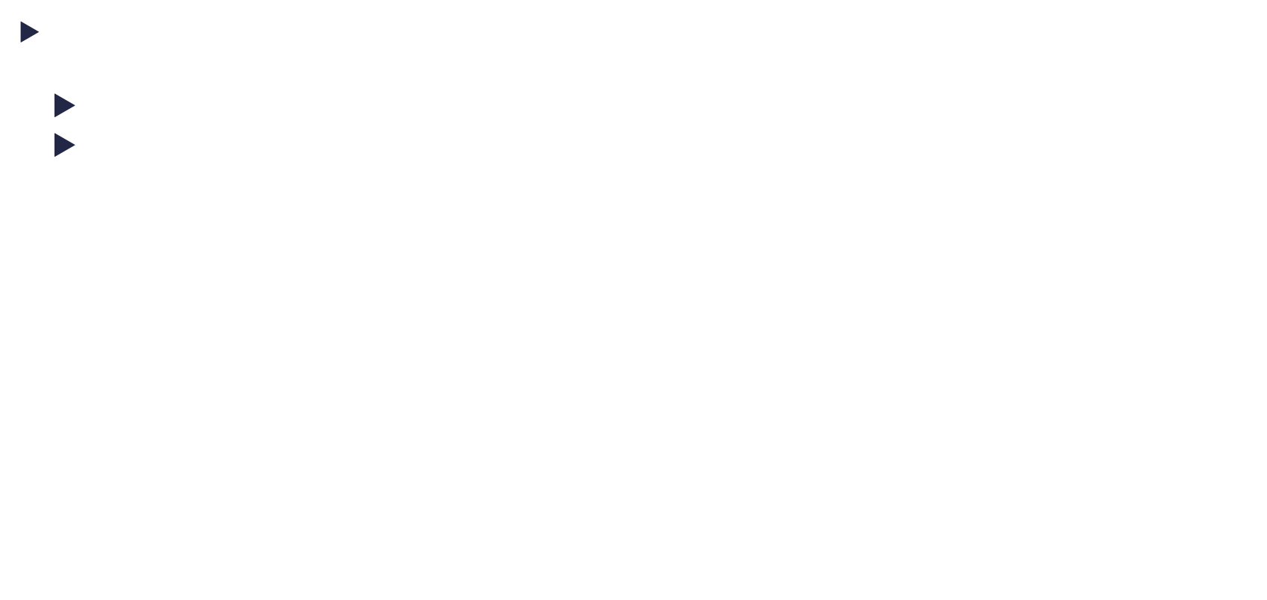

Backpropagation Through Time
When the output is the result of multiple previous time steps, we need to consider that:
The output ($y_{t})$ depends also on previous inputs through $h_{t}$
that $h_{t}$ is computed based on $h_{t−1}$
(this is only for a loss based on a single output)
$$\frac{∂L_{t}}{∂W_{xh}}=\sum_{k=1}^{t}{\frac{∂L_{t}}{∂y_{t}}⋅\frac{∂y_{t}}{∂h_{t}}⋅\left(\prod_{j=k+1}^{t}{\frac{∂h_{j}}{∂h_{j−1}}}\right)⋅\frac{∂h_{k}}{∂W_{xh}}}$$
Loss to hidden
Temporal Propagation
Hidden to weight
Notes:
Sursa e aici:
For din pi te duce de la t pana la t-I +1 https://www.pycodemates.com/2023/08/backpropagation-through-time-explained-with-derivations.html Aici cred ca mi-a fost mai clar: https://courses.cs.washington.edu/courses/csep517/20wi/slides/csep517wi20-RNNs.pdf

Slide 23


















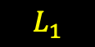
Backpropagation Through Time
$$L_{1}$$
$$L_{2}$$
$$L_{3}$$
If we have multiple – outputs, then we need to add the losses for each output
$$y_{t−2}$$
$$y_{2}$$
$$y_{3}$$
$$W_{hy}^{}$$
$$W_{hy}^{}$$
$$W_{hy}^{}$$
$$\frac{∂L}{∂W}=\sum_{t=1}^{T}{\frac{∂L_{t}}{∂W}}$$
$$h_{1}^{}$$
$$h_{2}^{}$$
$$h_{3}^{}$$
$$W_{hh}^{}$$
$$W_{hh}^{}$$
$$W_{hh}^{}$$
$$W_{xh}$$
$$W_{xh}$$
$$W_{xh}$$
$$x_{1}$$
$$x_{2}$$
$$x_{3}$$
Notes:
Sursa e aici:
For din pi te duce de la t pana la t-I +1 https://www.pycodemates.com/2023/08/backpropagation-through-time-explained-with-derivations.html

Slide 24
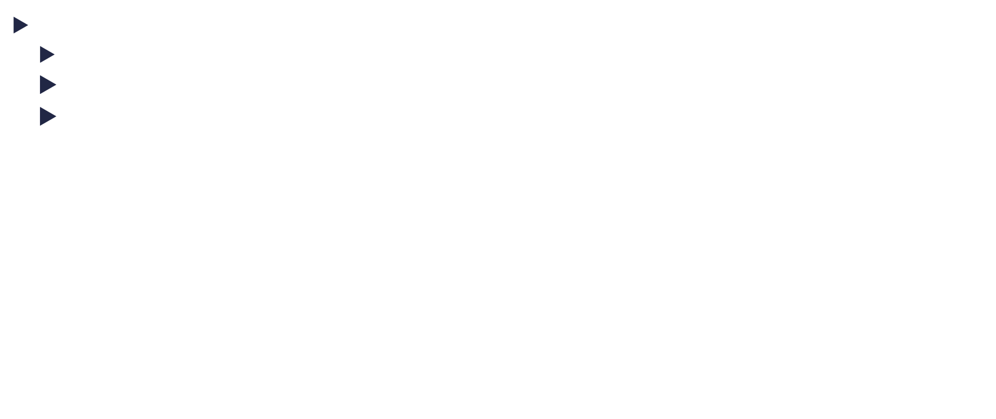

Backpropagation Through Time
When computing for multiple time steps we need to take into consideration
The loss at each time step (if there is one)
The output ($y_{3})$ depends also on previous inputs through $h_{t}$
that $h_{t}$ is computed based on $h_{t−1}$
$$\frac{∂L}{∂W_{xh}}=\sum_{t=1}^{T}{\left(\sum_{k=1}^{t}{\frac{∂L_{t}}{∂y_{t}}⋅\frac{∂y_{t}}{∂h_{t}}⋅\left(\prod_{j=k+1}^{t}{\frac{∂h_{j}}{∂h_{j−1}}}\right)⋅\frac{∂h_{k}}{∂W_{xh}} }\right)}$$
Every loss
Loss to hidden
Temporal Propagation
Hidden to weight
Notes:
Sursa e aici:
For din pi te duce de la t pana la t-I +1 https://www.pycodemates.com/2023/08/backpropagation-through-time-explained-with-derivations.html

Slide 25

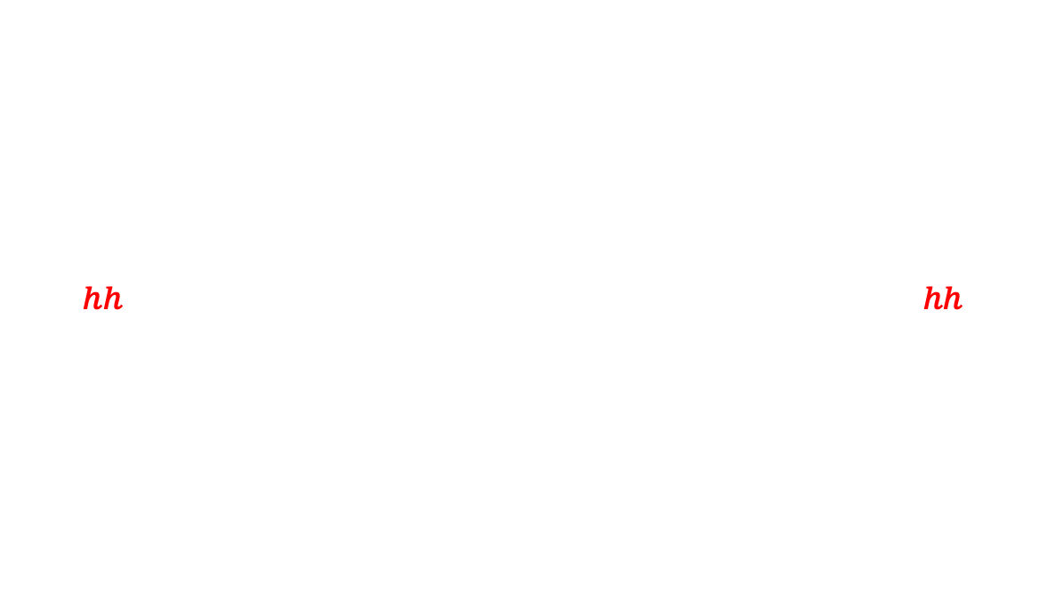
Backpropagation Through Time
If we want to compute the gradients for w.r.t to $W_{hh}$, the formula is almost the same. This is because $h_{t}$ is computed based on $W_{hh}$ and $W_{xh}$ and $h_{t−1}$.
$$\frac{∂L}{∂W_{hh}}=\sum_{t=1}^{T}{\left(\sum_{k=1}^{t}{\frac{∂L_{t}}{∂y_{t}}⋅\frac{∂y_{t}}{∂h_{t}}⋅\left(\prod_{j=k+1}^{t}{\frac{∂h_{j}}{∂h_{j−1}}}\right)⋅\frac{∂h_{k}}{∂W_{hh}} }\right)}$$
Every loss
Loss to hidden
Temporal Propagation
Hidden to weight
Notes:
Sursa e aici:
For din pi te duce de la t pana la t-I +1 https://www.pycodemates.com/2023/08/backpropagation-through-time-explained-with-derivations.html

Slide 26


Backpropagation Through Time
The gradients w.r.t to the output weights $W_{hy}$ are more simple since when computing the chain rule we don’t need to reach to $h_{t}$
$$\frac{∂L}{∂W_{hy}}=\sum_{i=1}^{t}{\frac{∂L}{∂y_{i}}\frac{∂y_{i}}{∂W_{hy}}}$$
Notes:
Sursa e aici: https://www.pycodemates.com/2023/08/backpropagation-through-time-explained-with-derivations.html

Slide 27
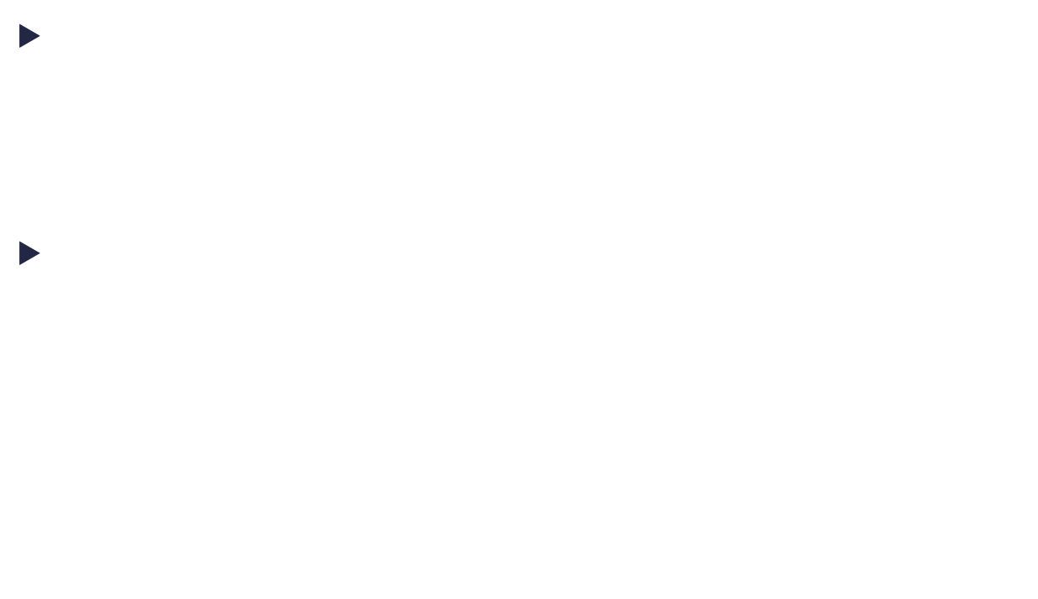







Backpropagation Through Time
$$y_{t}$$
Multiple RNN modules can be stacked one on each other, similar on how layers are being stacked on a standard neural network
We add an additional set of weights, $W_{hhd}^{l}$ to connect the hidden laers of the two RNNs
$$W_{hy}^{}$$
$$h_{t}^{l+1}$$
$$W_{hht}^{l+1}$$
$$W_{hhd}^{l}$$
$$h_{t}^{l}$$
$$W_{hht}^{l}$$
$$W_{xh}$$
$$x_{t}$$
Notes:
Sursa e aici: https://www.pycodemates.com/2023/08/backpropagation-through-time-explained-with-derivations.html

Slide 28



























Backpropagation Through Time
The network can be unfolded, just like a neural network with one hidden RNN.
$$y_{t−2}$$
$$y_{t−1}$$
$$y_{t}$$
$$W_{hy}^{}$$
$$W_{hy}^{}$$
$$W_{hy}^{}$$
$$h_{t−2}^{l+1}$$
$$h_{t−1}^{l+1}$$
$$h_{t}^{l+1}$$
$$h_{t−3}^{l+1}$$
$$W_{hh}^{l+1}$$
$$W_{hh}^{l+1}$$
$$W_{hh}^{l+1}$$
$$W_{hhd}^{l}$$
$$W_{hhd}^{l}$$
$$W_{hhd}^{l}$$
$$h_{1}^{l}$$
$$h_{1}^{l}$$
$$h_{1}^{l}$$
$$h_{t−3}^{l}$$
$$W_{hht}^{l}$$
$$W_{hht}^{l}$$
$$W_{hht}^{l}$$
$$W_{xh}$$
$$W_{xh}$$
$$W_{xh}$$
$$x_{t−2}$$
$$x_{t−1}$$
$$x_{t}$$
Notes:
Sursa e aici: https://www.pycodemates.com/2023/08/backpropagation-through-time-explained-with-derivations.html

Slide 29
RNN in pytorch

Slide 30
RNN in pytorch
Pytorch has support for RNN modules: torch.nn.RNN
The data can be provided in the following formats:
(SEQ_NR, BatchSize, data shape) or (BatchSize, SEQ_NR, data shape)
All data from the same batch have the same number of sequences. This is because of how the GPU works
If this is not the case (as for most of sequence data), you can use the method: torch.nn.utils.rnn.pack_sequence

Slide 31
RNN in pytorch
Parameters
sequences (list[Tensor]) – A list of sequences of decreasing length.
enforce_sorted (bool, optional) – if True, checks that the input contains sequences sorted by length in a decreasing order. If False, this condition is not checked. Default: True.
import torch
from torch.nn.utils.rnn import pack_sequence
a = torch.tensor([1, 2, 3])
b = torch.tensor([4, 5])
c = torch.tensor([6])
x = pack_sequence([a, b, c])
print(x)
Output
PackedSequence(data=tensor([1, 4, 6, 2, 5, 3]), batch_sizes=tensor([3, 2, 1]), sorted_indices=None, unsorted_indices=None)
Notes:
Ce se intampla in spate e ca-ti calculeaza dimensiunea batch-ului astfel incat sa ai acelasi numarul de elemente intr-un batch la fiecare timestep
Iti unesc toate elementele intr-un singur vector , dar pe secventa. Adica pe prima pozitie vor fi prima secventa din toate elmentele, pe a doua pozitie a doua secventa din toate elementele, a 3.. La fel.. Depinde daca mai exista a 3-a secventa pentru nele elemente… batchsize-ul spune cate elemente au secventa respective
Vei avea un batch de forma atsa : (10,10, 9, 8, 6, 6. ). Asta inesamna de fapt ca iti treimite la fiecare rnn pe rand, in total 6 batch-uri

Slide 32
Backpropagation Through Time
Parameters
input_size – The number of expected features in the input x
hidden_size – The number of features in the hidden state h
num_layers – Number of recurrent layers. E.g., setting num_layers=2 would mean stacking two RNNs together to form a stacked RNN, with the second RNN taking in outputs of the first RNN and computing the final results. Default: 1
nonlinearity – The non-linearity to use. Can be either 'tanh' or 'relu'. Default: 'tanh'
bias – If False, then the layer does not use bias weights b_ih and b_hh. Default: True
batch_first – If True, then the input and output tensors are provided as (batch, seq, feature) instead of (seq, batch, feature). Note that this does not apply to hidden or cell states. See the Inputs/Outputs sections below for details. Default: False
dropout – If non-zero, introduces a Dropout layer on the outputs of each RNN layer except the last layer, with dropout probability equal to dropout. Default: 0
bidirectional – If True, becomes a bidirectional RNN. Default: False

Slide 33
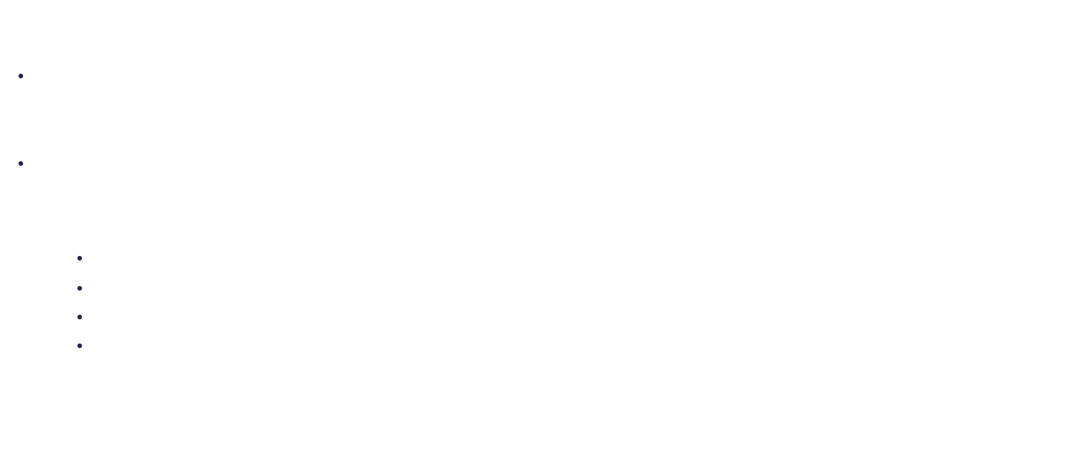
RNN in pytorch
The Input for this tensor is a tuple ($input$, $h_{0})$:
input: tensor of shape $\left(L, H_{in}\right)$for unbatched input, tensor of shape $\left(L, N, H_{in}\right)$ when batch_first=False or tensor of shape $\left(N, L, H_{in}\right)$ when batch_first=True
$h_{0}$: tensor of shape ($num_layers$, $H_{out}$) for unbached input, tensor of shape ($num_layers$, $N, { H}_{out}$) for batched input
where:
$L$ is the length of the sequence
$N$ is the size of the minibatch
$H_{in}$ is the hidden input size
$H_{out}$ is the hidden output size
It is the responsibility of the programmer to allocate memory for the hidden state and to initialize it with zeros
Notes:
Aici e ce primeste de fapt prin forward.
Explica aici ca trebuie sa dam noi tensori de tip h0

Slide 34
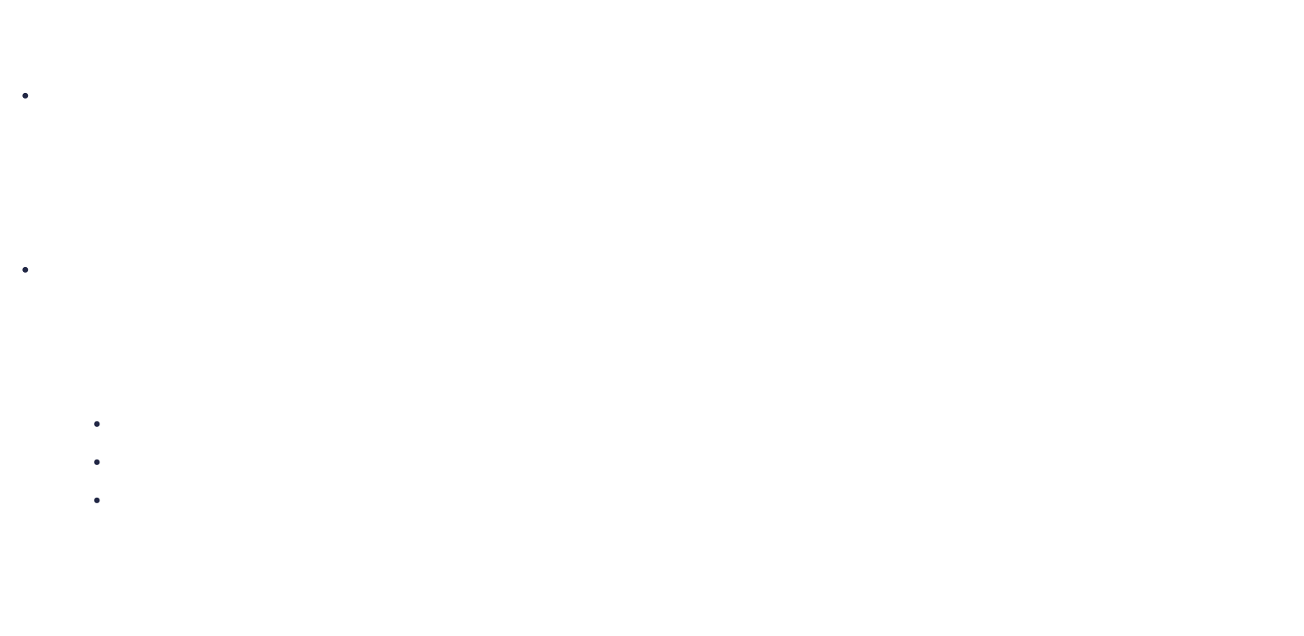
RNN in pytorch
The Output for this tensor is a tuple ($output$, $h_{n})$:
output: tensor of shape $\left(L, {1, H}_{out}\right)$for unbatched input, tensor of shape $\left(L, N, {1, H}_{out}\right)$ when batch_first=False or tensor of shape $\left(N, L, {1, H}_{out}\right)$ when batch_first=True containing the output from the last layer of the RNN at each timestep
$h_{n}$: tensor of shape ($num_layers$, $H_{out}$) for unbached input, tensor of shape ($num_layers$, $N, { H}_{out}$) for batched input containing the final hidden state for each element in the batch
where:
$L$ is the length of the sequence
$N$ is the size of the minibatch
$H_{out}$ is the hidden output size
The programmer decides how to use the output at each time step. For example, use only the final output or use the outputs at each timestep
Notes:
$\left(L, {1, H}_{out}\right)$ pentru ca poti implementa si bidirectional, iar in cazul asta va fi 2 in loc de 1. Ila o retea bidirectionala, ai 2 straturi hidden, unul conectat inainte, altul conectat inapoi, ambele dau un output
Spune ca la output ai o tupla din 2 tensori:
1. outputul al fiecare pos, deci ai batch si scevente
2. ultimul hidden state, pentr fiecare layer
Pentru un singur layer si unidirectional, ultimul output este egal cu h_n

Slide 35
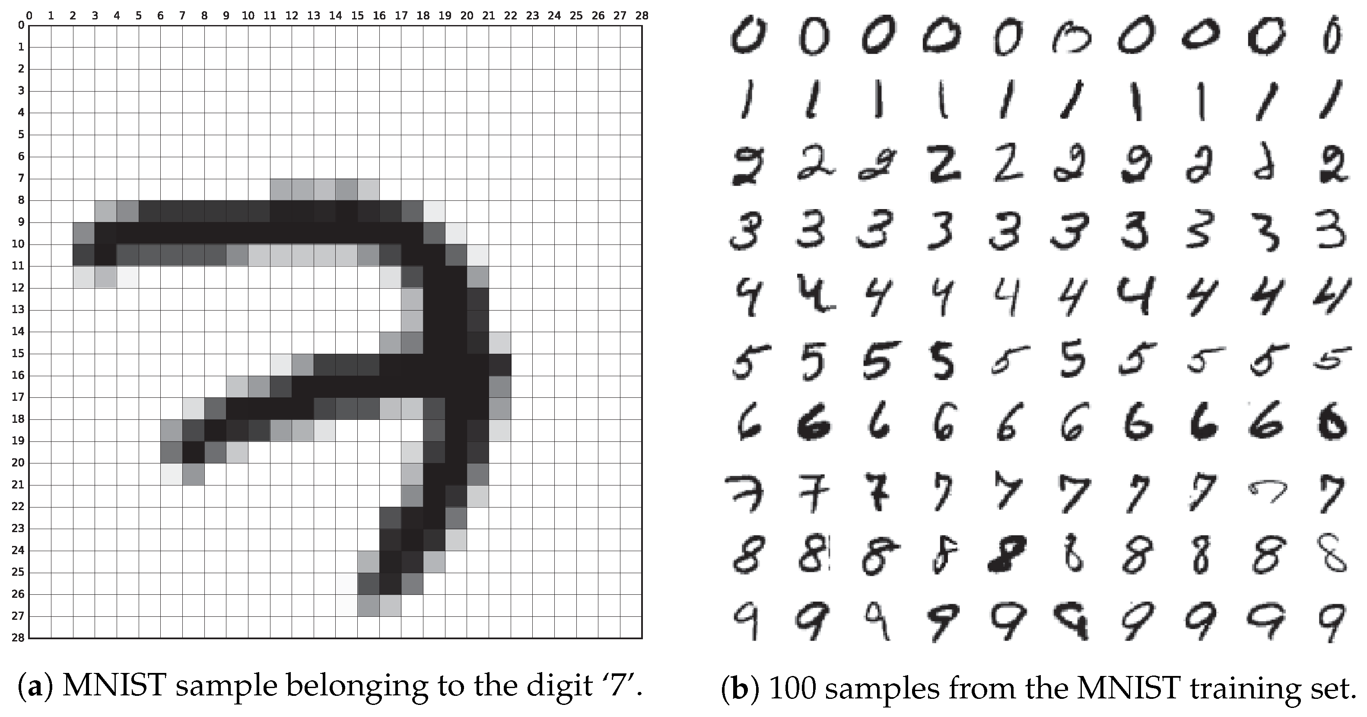
RNN in pytorch
Train a RNN on MNIST digits:
Normally, mnist digits are not necessarily sequence data, but they can be transformed into one:
We can view a digit as a sequence of length 28, while each element from the sequence has the length 28
Notes:
Relu nu e bounded sus, deci explodeaza rpd

Slide 36
RNN in pytorch
Define the necessary imports
# Imports
import torch
import torch.nn.functional as F # for activation functions
import torchvision.datasets as datasets # for MNIST
import torchvision.transforms as transforms # convert into tensor
from torch import optim # For optimizers like Adam
from torch import nn # For RNN
from torch.utils.data import DataLoader # for batching
from tqdm import tqdm # For a rogress bar!
device = "cuda" if torch.cuda.is_available() else "cpu"

Slide 37
RNN in pytorch
Set the hyperparameters
# Hyperparameters
input_size = 28
hidden_size = 256
num_layers = 2
num_classes = 10
sequence_length = 28
learning_rate = 0.001
batch_size = 64
num_epochs = 10
Our RNN will have two layers, each with a hidden vector of 256 elements

Slide 38
RNN in pytorch
class RNN(nn.Module):
def __init__(self, input_size, hidden_size, num_layers, num_classes):
super(RNN, self).__init__()
self.hidden_size = hidden_size
self.num_layers = num_layers
self.rnn = nn.RNN(input_size, hidden_size, num_layers, batch_first=True)
self.fc = nn.Linear(hidden_size * sequence_length, num_classes)
Store the configuration.
Define the RNN layers:
the input size: the size of each element in the sequence 28 * hidden_size : the number of neurons in each hidden layer:256 * num_layers: the number of hidden layer: 2 * batch_first : the data will be in the following format (N, S, 28 ) = ( 64, 28, 28)
Add a hidden layer that connects the output at each time step to the an output layer . (many to one)

Slide 39
RNN in pytorch
class RNN(nn.Module):
...
def forward(self, x):
# Set initial hidden and cell states
h0 = torch.zeros(self.num_layers, x.size(0), self.hidden_size).to(device)
# Forward propagate LSTM
out, _ = self.rnn(x, h0)
out = out.reshape(out.shape[0], -1)
# Decode the hidden state of the last time step
out = self.fc(out)
return out
Initialize the hidden vector of each layer.
There must be one hidden vector per layer, per input in the minibatch. The size of each vector we’ve defined in the configuration

Slide 40
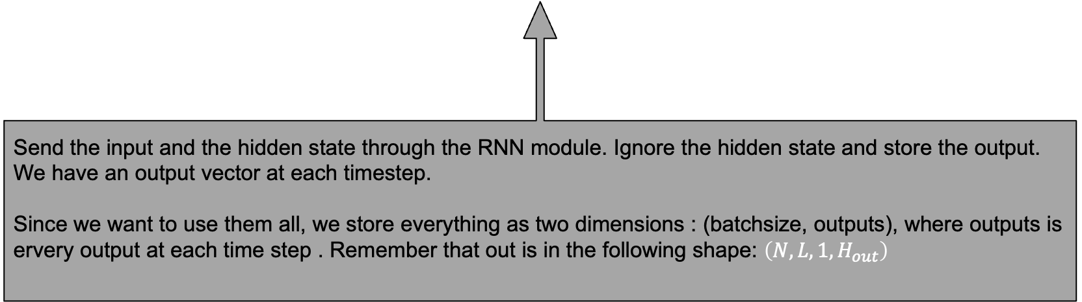
RNN in pytorch
class RNN(nn.Module):
...
def forward(self, x):
# Set initial hidden and cell states
h0 = torch.zeros(self.num_layers, x.size(0), self.hidden_size).to(device)
# Forward propagate LSTM
out, _ = self.rnn(x, h0)
out = out.reshape(out.shape[0], -1)
# Decode the hidden state of the last time step
out = self.fc(out)
return out
Send the input and the hidden state through the RNN module. Ignore the hidden state and store the output. We have an output vector at each timestep. Since we want to use them all, we store everything as two dimensions : (batchsize, outputs), where outputs is ervery output at each time step . Remember that out is in the following shape: $\left(N, L, {1, H}_{out}\right)$

Slide 41
RNN in pytorch
class RNN(nn.Module):
...
def forward(self, x):
# Set initial hidden and cell states
h0 = torch.zeros(self.num_layers, x.size(0), self.hidden_size).to(device)
# Forward propagate LSTM
out, _ = self.rnn(x, h0)
out = out.reshape(out.shape[0], -1)
# Decode the hidden state of the last time step
out = self.fc(out)
return out
Connect all the outputs to a fully connected layer. The output of the fully connected layers is the classification of the input

Slide 42
RNN in pytorch
Download mnist data
# Load Data
train_dataset = datasets.MNIST(
root="dataset/", train=True, transform=transforms.ToTensor(), download=True)
test_dataset = datasets.MNIST(
root="dataset/", train=False, transform=transforms.ToTensor(), download=True)
train_loader = DataLoader(dataset=train_dataset, batch_size=batch_size,shuffle=True)
test_loader = DataLoader(dataset=test_dataset, batch_size=batch_size, shuffle=True)
Download the mnist training and testing dataset.
Transforms.ToTensor just converts the input to tensor. Initialize two DataLoaders, one for training and one for testing, using a batch_size of 64

Slide 43
RNN in pytorch
Initialize the model
# Initialize network
model = RNN(input_size, hidden_size, num_layers, num_classes).to(device)
# Loss and optimizer
criterion = nn.CrossEntropyLoss()
optimizer = optim.Adam(model.parameters(), lr=learning_rate)
Initialize the network and transfer the model to the detected device(i.e. gpu)
Initialize a cross function: CrossEntropy Intialize an optimizer with the model parameters : Adam.

Slide 44
RNN in pytorch
for epoch in range(num_epochs):
for batch_idx, (data, targets) in enumerate(tqdm(train_loader)):
# Get data to cuda if possible
data = data.to(device=device).squeeze(1)
targets = targets.to(device=device)
# forward
scores = model(data)
loss = criterion(scores, targets)
# backward
optimizer.zero_grad()
loss.backward()
# gradient descent update step/adam step
optimizer.step()
The shape of a tensor from MNIST is: (batchsize, 1, 28, 28). By calling squeeze (2) we remove the redundant 1.

Slide 45
RNN in pytorch
Results from training using a RNN:
100%|█████████████████████████████████████████████████| 938/938 [00:09<00:00, 103.25it/s]
100%|█████████████████████████████████████████████████| 938/938 [00:08<00:00, 105.08it/s]
100%|█████████████████████████████████████████████████| 938/938 [00:09<00:00, 103.99it/s]
100%|█████████████████████████████████████████████████| 938/938 [00:08<00:00, 104.78it/s]
100%|█████████████████████████████████████████████████| 938/938 [00:08<00:00, 104.75it/s]
100%|█████████████████████████████████████████████████| 938/938 [00:08<00:00, 105.23it/s]
100%|█████████████████████████████████████████████████| 938/938 [00:08<00:00, 104.77it/s]
100%|█████████████████████████████████████████████████| 938/938 [00:09<00:00, 103.04it/s]
100%|█████████████████████████████████████████████████| 938/938 [00:08<00:00, 105.49it/s]
100%|█████████████████████████████████████████████████| 938/938 [00:08<00:00, 104.97it/s]
Accuracy on training set: 98.411667
Accuracy on test set: 97.83

Slide 46
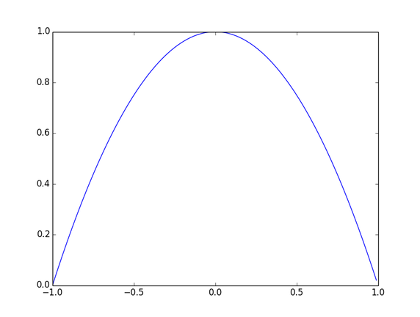
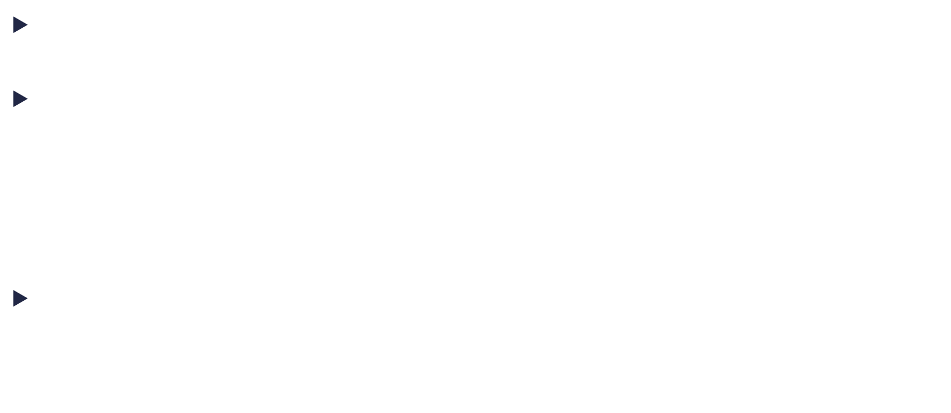
Backpropagation Through Time
An unfolded Recurrent Neural Network could be seen as a very deep neural network where the activation of each neuron is based on tanh
Since, when computing the gradient w.r.t. the weight, we need to compute
$$\frac{∂h_{k}}{∂h_{1}}=\frac{∂h_{k}}{∂h_{k−1}}\frac{∂h_{k−1}}{∂h_{k−2}}\frac{∂h_{k−1}}{∂h_{k−2}} …\frac{∂h_{2}}{∂h_{1}}$$
And $h_{t}^{}=\tanh\left(W_{hht}^{}h_{t−1 }^{}+W_{xh}x_{t}+b_{h}^{l}\right)$ that means we are multiplying (for each timestep) the gradient of tanh function
That means the gradient vanishes
Notes:
Deci chiar daca facem noi adunari, la ecuatia precdenta, de fapt adunam valori de 0.
Mai putin gradientii de la ultimele ecuatii

Slide 47
Backpropagation Through Time
Why no use relu instead of tanh ?
People have tried and didn’t work well. The reasons lies in the architecture of RNN. Hidden states are multiplicative
On very long sequences, weights could also lead to vanishing/ exploding the gradient. Controlling this is difficult since we’re using only 1set of weights for all the sequences (unfolded layers).
When using relu the problem is that relu is not bounded (i.e sigmoid or tanh). When used inside a RNN, causes a unit to have very large value for the activation function.
Notes:
Relu nu e bounded sus, deci explodeaza rpd

Slide 48
Recursive Neural Networks
Long Short Term Memory (LSTM)

Slide 49
Long Short Term Memory
Long Short Term Memory (LSTM) was invented in 1997 (Hochreiter & Schmidhuber ) in order to overcome the vanishing gradient problem in Vanilla RNN
Since a RNN can be viewed as a Neural Network with memory, the authors took the idea further and transformed the hidden layer of a RNN into a memory cell
As in memory, they consider the LSTM unit to support the following operations:
Reading
Writing (saving)
Deleting

Slide 50
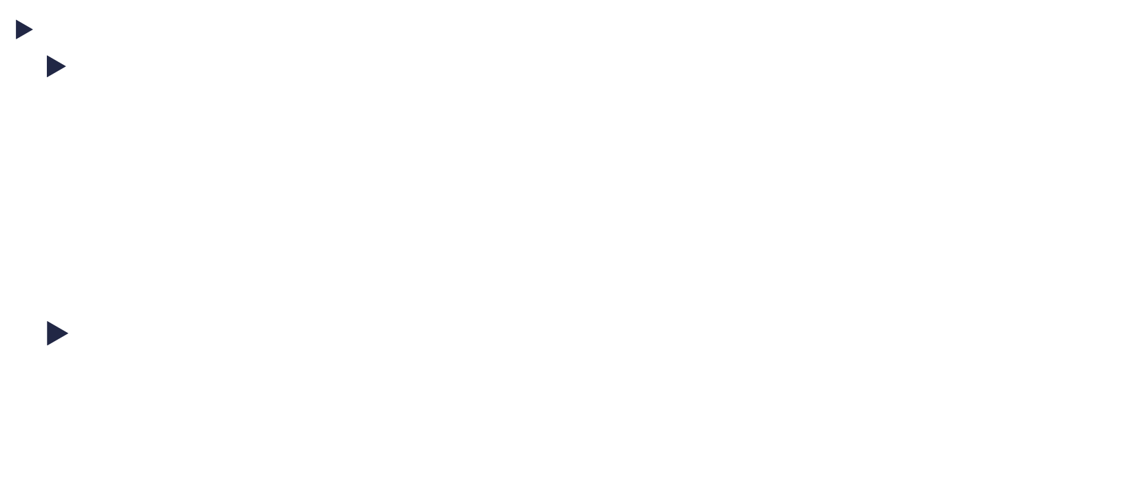
Long Short Term Memory
Solving the vanishing gradient problem:
The problem of Vanilla RNN was based on the fact that the current state is obtained by applying a tanh function on the adjusted previous state
We’ll use the notation $C_{t}$ for the state of the cell/unit at time $t$
In Vanilla RNN: $C_{t}=f_{w}\left(C_{t−1}\right)$ where $f_{w} is the Vanilla RNN function.$ $C_{t}=h_{t}$
In LSTM, in order to solve the vanishing gradient, $tanh$ is replaced by an addition In LSTM: $C_{t}=C_{t−1}+f_{context} (C_{t−1})$ $where f_{context} is a function we^{′}ll define later$
Notes:
So in LST we’re geting the previous memory where we add new information based on it

Slide 51


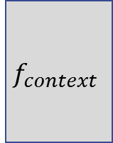


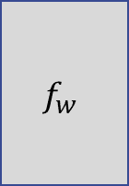

Long Short Term Memory
Solving the vanishing gradient problem:
The advantage of using the addition is that the derivates don’t get multiplied, but they get added. Thus, they don’t disappear
$C_{t}=C_{t−1}+f_{context} (C_{t−1})$
$C_{t}=C_{1}+f_{context}\left(C_{1}\right)+f_{context}\left(C_{2}\right)+…+f_{context}(C_{t−1})$
$$f_{context}$$
$$f_{w}$$
$$C_{t−1}$$
$$C_{t}$$
$$C_{t−1}$$
+
$$C_{t}$$
Vanilla RNN
LSTM
Notes:
Sa nu uitam ca C1 c2 ct sunt toti acelasi membru. Adica un fel de x
Cand fac derivate, astia nu sunt 0
Chiar daca o derivate este 0, avem altele care sa modfice weighturile

Slide 52














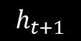









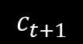
Long Short Term Memory
As stated earlier, the LSTM unit is viewed as a memory cell that supports reading, writing and deletion.
Reading doesn’t imply outputting the whole memory cell, but just parts of it. So the LSTM unit can be viewed as having an additional input/output vs the Vanilla RNN
$$h_{t−1}$$
$$h_{t}$$
$$h_{t+1}$$
$$h_{t−1}$$
$$h_{t}$$
$$h_{t+1}$$
$$RNN$$
$$c_{t−1}$$
$$RNN$$
$$c_{t}$$
$$RNN$$
$$c_{t+1}$$
$$RNN$$
$$RNN$$
$$RNN$$
$$h_{t−1}$$
$$h_{t}$$
$$h_{t+1}$$
$$h_{t−1}$$
$$h_{t}$$
$$h_{t+1}$$
$$x_{t−1}$$
$$x_{t}$$
$$x_{t+1}$$
$$x_{t−1}$$
$$x_{t}$$
$$x_{t+1}$$
Vanilla RNN
LSTM

Slide 53
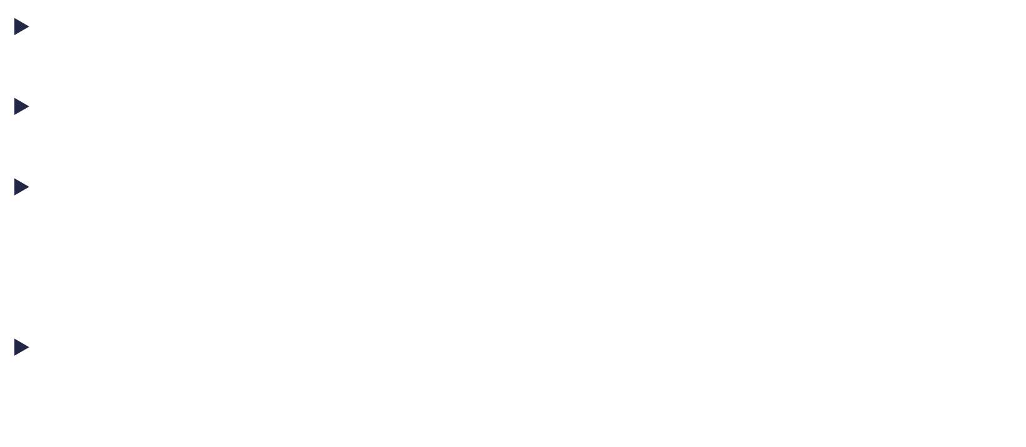
Long Short Term Memory
At each time step, the LSTM must output new information, store new information and forget unnecessary data .
This steps are determined by the cell state and a context. The context is given by the new input and what was outputted at the previous step.
Since we want our cell state to change based on what it sees, it makes sense to do that on what has been previously outputted and what is currently being read.
Based on this context ($h_{t−1},x_{t})$ we want to decide what to remember (delete from cell state), what to output (read from cell state) and what to bring in (write to cell state).
Images from http://www.wildml.com
Notes:
Reteaua trebuie sa decida: cememoreaza, ce sterge, ce trimite mai departe
Face asta pe abza unui context: ht + xt

Slide 54




Long Short Term Memory
Taking these decisions is hard, so we’ll use a separate neural network for each of these decisions.
For each decision, there can be two types of neural networks :
Decides how much information to use (gate)
Decide how to weight that information (negative, positive)
(the difference is in the activation function)
$${information}_{}$$
x
$${output}_{}$$
$$h_{t−1}$$
$$x_{t}$$
context
[0.8, 0.9, 0.1, 0.3]
Notes:
Spune ca informatia e sub forma de vector
Spune ca sigmoid e intre 0 si 1
Spune ca intre cele doua difera doar functia de actiavre

Slide 55




Long Short Term Memory
1. First type (gate): Decides how much information to use: The first type of neural network is computed using a sigmoid neuron, based on the context. The result is multiplied by the information.
$${information}_{}$$
x
$$filtered {information}_{}$$
Ex: [1.0, 0.9, 0.0, 0.7]
[0.8, 0.8, 0.0, 0.2]
$$h_{t−1}$$
$$x_{t}$$
context
[0.8, 0.9, 0.1, 0.3]
Notes:
Spune ca informatia e sub forma de vector
Spune ca sigmoid e intre 0 si 1
Spune ca intre cele doua difera doar functia de actiavre

Slide 56
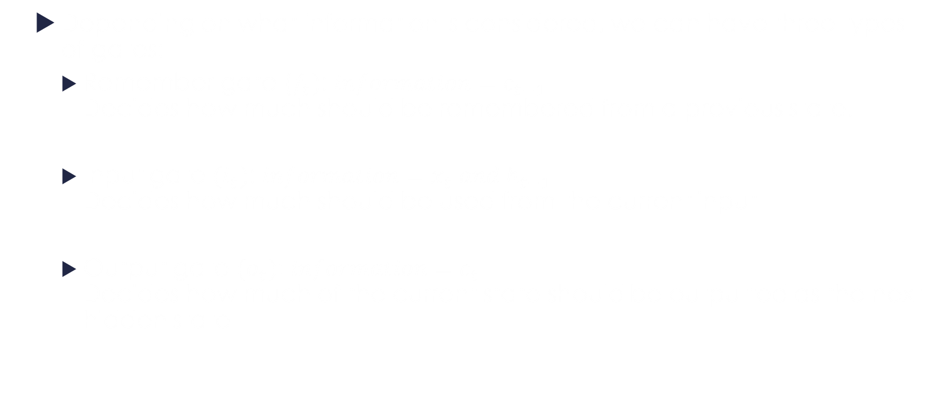
Long Short Term Memory
Depending on what information is considered, we can have three types of gates:
Remember gate ($f_{t})$: $information=c_{t−1}$ Decides how much should be remembered from a previous state.
Input gate $(i_{t})$: $information=x_{t} and h_{t−1}$ Decides how much should be used from the current input
Output gate $(o_{t})$: $information=c_{t}$ Decides how much of the current state should be outputted as the next hidden state

Slide 57




Long Short Term Memory
Decides the sign of information: The second neural network is computed using a tanh neuron, based on the context. The result is multiplied by the information.
Since tanh outputs information in the interval -1,1 we can view it as a counter for the information.
A negative input might be as important as a positive one so we need this kind of information.
$$information$$
x
$$weighted information$$
Ex: [1.0, 0.9, 0.0, 0.7]
[0.9,- 0.8, 0.0, -0.2]
tanh
$$h_{t−1}$$
$$x_{t}$$
context
[0.9, -0.9, 0.2, -0.3]
Notes:
Gandeste-te ca vrei sa stii daca te duci afara. Pozitiv ar insemna ca afara e soare. Dar poate vrei sa satii ca nu te duci daca afara ploua. Poti avea si date intre

Slide 58
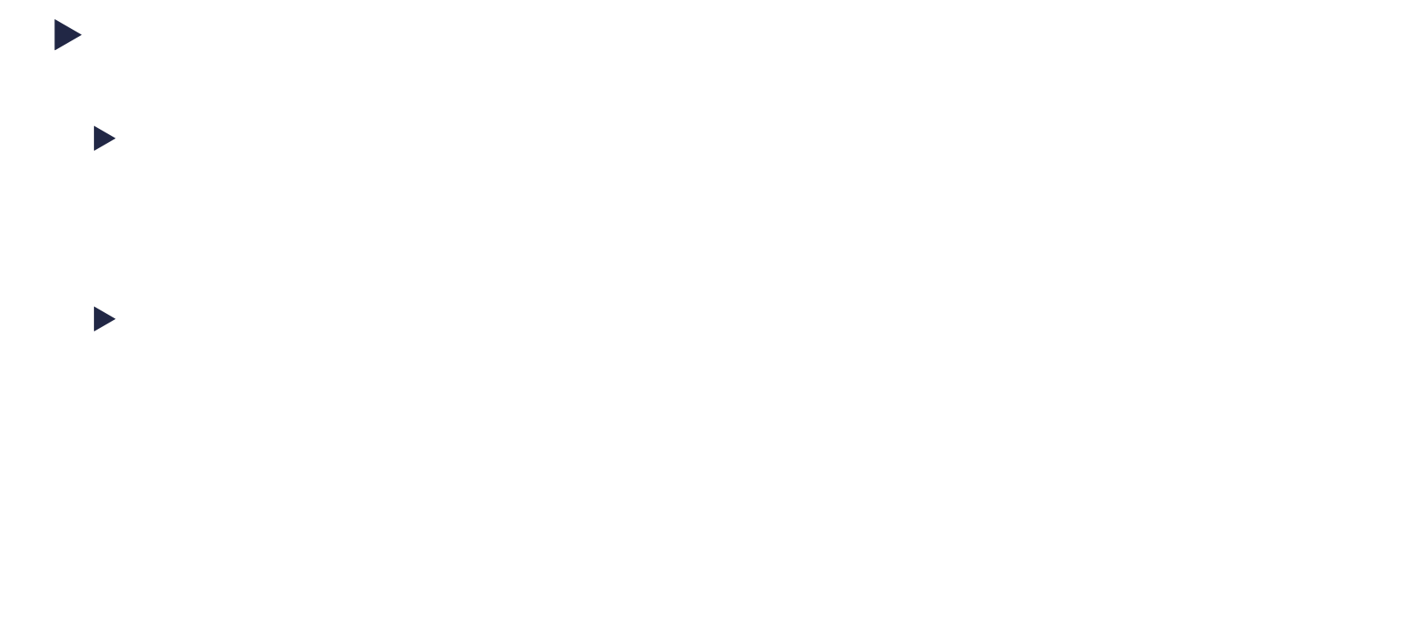
Long Short Term Memory
This kind of network is used in two places:
With Input gate($g_{t})$: $information={(x}_{t} and h_{t−1})$ Decides which of the input should be positive or negative. The amount will also be adjusted by the input gate.
With Output gate: $information=c_{t}$ Decides which of the information contained by current state is positive and which is negative. The amount will also be adjusted by the output gate

Slide 59












Long Short Term Memory
$$C_{t−1}$$
x
+
$$C_{t}$$
$$f$$
$$i$$
x
$$g$$
tanh
tanh
$$h_{t−1}$$
$$o$$
x
$$h_{t}$$
$$x_{t}$$
Gates:
$f_{t}=σ\left(W_{xf}x_{t}+W_{hf}h_{t−1}+b_{f}\right)$
$i_{t}=σ(W_{xi}x_{t}+W_{hi}h_{t−1}+b_{i})$
$o_{t}=σ(W_{xo}x_{t}+W_{ho}h_{t−1}+b_{0})$
State and output:
$g_{t}=tanh\left(W_{xg}x_{t}+W_{hg}h_{t−1}+b_{g}\right)$
$C_{t}=f_{t}⊙C_{t−1}+i_{t}⊙g_{t}$
$h_{t}=o_{t}⊙tanh⁡(C_{t})$
$$⊙ =element−wise multiplication$$
Notes:
Deci, ft, it si ot sunt niste layere inmultite cu inputul. Nu sunt altceva decat niste fully connected
Tanh-ul inainte de output e .

Slide 60

Long Short Term Memory
Why doesn’t the gradient disappear?
$$C_{t}=f_{t}⊙C_{t−1}+i_{t}⊙g_{t}$$
1. The short (incomplete) answer :
$\frac{∂C_{t}}{∂C_{t−1}}=f_{t}$
this makes sense since $f_{t}$ controls how much of the previous state to keep for the current state
2. The long answer $f_{t}$ , $i_{t}$ and $g_{t}$ all depend on $C_{t−1}$ or on $h_{t−1}$ (which also depends on $C_{t−1}$). So the way the above derivate is computed is incomplete

Slide 61
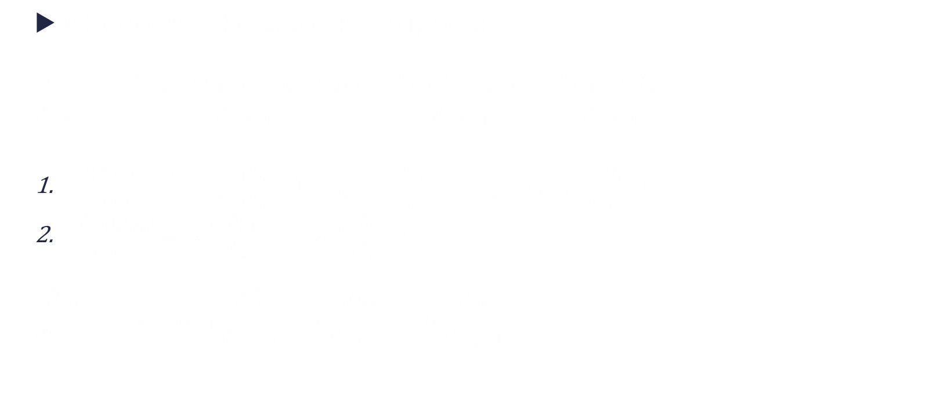
Long Short Term Memory
Why doesn’t the gradient disappear?
$$\frac{∂C_{t}}{∂C_{t−1}}=\frac{∂\left(f_{t}⊙C_{t−1}+i_{t}⊙g_{t}\right)}{∂C_{t−1}}=\frac{∂\left(f_{t}⊙C_{t−1}\right)}{∂C_{t−1}}+\frac{∂\left(i_{t}⊙g_{t}\right)}{∂C_{t−1}}$$
$\frac{∂\left(f_{t}⊙C_{t−1}\right)}{∂C_{t−1}}=f_{t}\left(\frac{∂C_{t−1}}{∂C_{t−1}}\right)+c_{t−1}\left(\frac{∂f_{t}}{∂C_{t−1}}\right)=f_{t}+c_{t−1}\left(\frac{∂f_{t}}{∂C_{t−1}}\right)$
$\frac{∂\left(i_{t}⊙g_{t}\right)}{∂C_{t−1}}=i_{t}\left(\frac{∂g_{t}}{∂C_{t−1}}\right)+g_{t}\left(\frac{∂i_{t}}{∂C_{t−1}}\right)$
$$\frac{∂C_{t}}{∂C_{t−1}}=f_{t}+c_{t−1}\frac{∂f_{t}}{∂C_{t−1}}+i_{t}\frac{∂g_{t}}{∂C_{t−1}}+g_{t}\frac{∂i_{t}}{∂C_{t−1}}$$
Notes:
1, 2Derivation rule for product

Slide 62
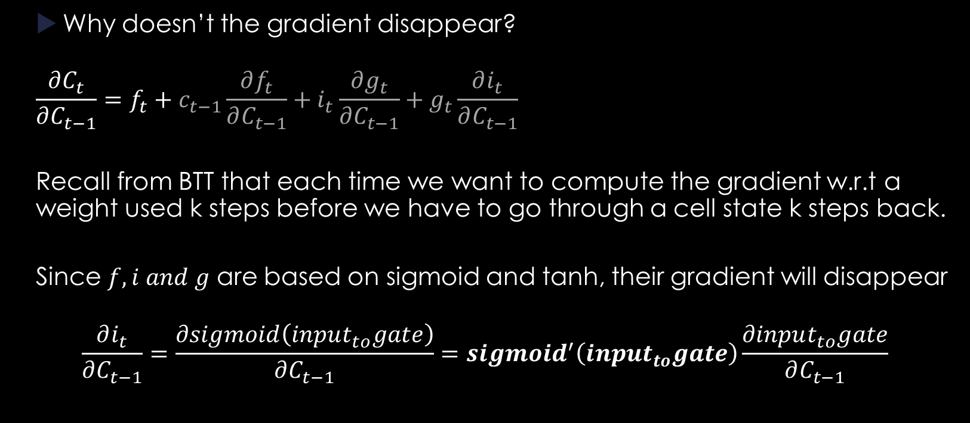
Long Short Term Memory
Why doesn’t the gradient disappear?
$$\frac{∂C_{t}}{∂C_{t−1}}=f_{t}+c_{t−1}\frac{∂f_{t}}{∂C_{t−1}}+i_{t}\frac{∂g_{t}}{∂C_{t−1}}+g_{t}\frac{∂i_{t}}{∂C_{t−1}}$$
Recall from BTT that each time we want to compute the gradient w.r.t a weight used k steps before we have to go through a cell state k steps back.
Since $f, i and g$ are based on sigmoid and tanh, their gradient will disappear
$$\frac{∂i_{t}}{∂C_{t−1}}=\frac{∂sigmoid\left(input_{to}gate\right)}{∂C_{t−1}}=sigmoid^{′}\left(input_{to}gate\right)\frac{∂input_{to}gate}{∂C_{t−1}}$$

Slide 63

Long Short Term Memory
Why doesn’t the gradient disappear?
So, on long sequences $\frac{∂C_{t}}{∂C_{t−1}}=f_{t}$.
However, this means that when we want to compute $\frac{∂C_{t}}{∂C_{k}}$ the gradient will look something like this: $f_{t}⊙f_{t−1}⊙f_{t−2}⊙…⊙f_{k}$.

Slide 64

Long Short Term Memory
Why doesn’t the gradient disappear?
I.e. if we want to compute the gradient w.r.t $W_{xi}$ at time 3. This would be:
$$\sum_{k=1}^{Y}{\frac{∂E}{∂y_{k}}\frac{∂y_{k}}{∂C_{3}}\frac{∂C_{3}}{∂W_{xi}}}=\frac{∂E}{∂y_{1}}\frac{∂y_{1}}{∂C_{3}}\frac{∂C_{3}}{∂W_{xi}}+\frac{∂E}{∂y_{2}}\frac{∂y_{2}}{∂C_{3}}\frac{∂C_{3}}{∂W_{xi}}+…+\frac{∂E}{∂y_{n}}\frac{∂y_{n}}{∂C_{3}}\frac{∂C_{3}}{∂W_{xi}}$$
The first 3 terms will be 0, since C3 existed only after the first outputs have been computed.
Let’s take one separately: $\frac{∂E}{∂y_{n}}\frac{∂y_{n}}{∂C_{3}}\frac{∂C_{3}}{∂W_{xi}}$ for n =100
Notes:
Tine minte ca daca eraore depinde de mai multe output r se calcuealza eraore in functie ed fiecare output si se insumeaza

Slide 65
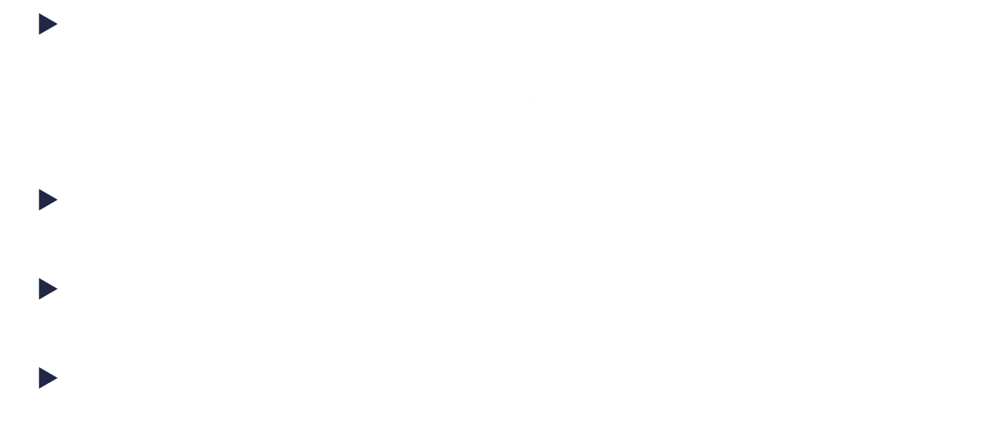
Long Short Term Memory
Why doesn’t the gradient disappear?
$\frac{∂E}{∂y_{100}}\frac{∂y_{100}}{∂C_{3}}\frac{∂C_{3}}{∂W_{xi}}=\frac{∂E}{∂y_{100}}\frac{∂y_{100}}{∂C_{100}}⊙f_{100}⊙f_{99}⊙f_{98}…⊙f_{5}⊙f_{4}⊙\frac{∂C_{3}}{∂W_{xi}}$
If one of these $f_{t}$ is zero the gradient will die.
This is desirable since we can consider that the current gradient doesn’t depend on information obtained prior to the $f_{t}=0$
If long term dependencies have to be maintained then all $f_{i}$ must be close to 1.
Since $f_{i}$ is random at initialize time, a good strategy to make the network learn is to initialize it with 1 (set bias at large value)

Slide 66

Long Short Term Memory
What about the other gates ? How are they adjusted?
The gradient of all the other gates is expressed based on $C_{t}$ (and we know this gradient doesn’t vanish)
This makes sense when we look at an example: $C_{4}=f_{4}⊙c_{3}+i_{4}⊙g_{4}=$
$$=f_{4}⊙\left(f_{3}⊙c_{2}+i_{3}⊙g_{3}\right)+i_{4}⊙g_{4}= \\ =f_{4}⊙\left(f3⊙\left(f_{2}⊙c_{1}+i_{2}⊙g_{2}\right)+i_{3}⊙g_{3}\right)+i_{4}⊙g_{4}= \\ =f_{4}⊙f_{3}⊙f_{2}⊙c_{1}+f_{4}⊙f_{3}⊙i_{2}⊙g_{2}+f_{4}⊙i_{3}⊙g_{3}+i_{4}⊙g_{4}$$
I.e. The derivative of $\frac{∂C_{4}}{∂g_{2}}=f_{4}⊙f_{3}⊙i_{2}$
Notes:
Asta are sens intrucat i2 controelaza cat g2 vrem, f3 controleaza cat c2 vrem iar f4 contoleaza cat c3 vrem

Slide 67
Variations of LSTM

Slide 68




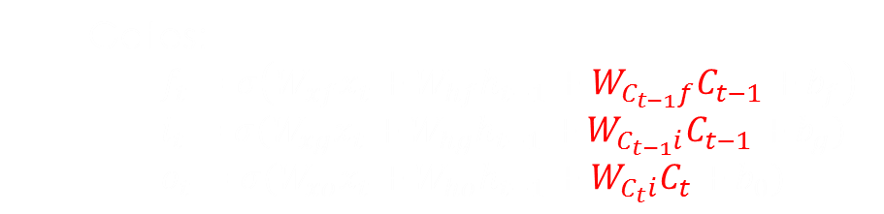






Variations of LSTM
LSTM with PeepHole: context depends on the previous/current state
$$C_{t−1}$$
x
+
$$C_{t}$$
$$f$$
$$i$$
x
$$g$$
tanh
tanh
$$h_{t−1}$$
$$o$$
x
$$h_{t}$$
$$x_{t}$$
Gates:
$f_{t}=σ\left(W_{xf}x_{t}+W_{hf}h_{t−1}+W_{C_{t−1}f}C_{t−1}+b_{f}\right)$
$i_{t}=σ(W_{xg}x_{t}+W_{hg}h_{t−1}+W_{C_{t−1}i}C_{t−1}+b_{g})$
$o_{t}=σ(W_{xo}x_{t}+W_{ho}h_{t−1}+W_{C_{t}i}C_{t}+b_{0})$
State and output:
$g_{t}=tanh\left(W_{xg}x_{t}+W_{hg}h_{t−1}+b_{g}\right)$
$C_{t}=f_{t}⊙C_{t−1}+i_{t}⊙g_{t}$
$h_{t}=o_{t}⊙tanh⁡(C_{t})$
Notes:
Ca operatiile sa mearga. Ft, ct, it trebuie sa aiba acelasi size.
Si ai si niste matrici care te ajtua sa tarnsformi inputul in size-ul corespunzator

Slide 69
Variations of LSTM
One disadvantage of LSTM is that it is not able to observe the state which it tries to control through the gates
Standard LSTM learns to detect markers and act. However, if these markers don’t exist the network behaves poorly.
If the output gate is closed, the value of the hidden unit (which becomes input at the next time step) becomes 0
The solution is to make the most recent cell state available to the gates
Notes:
Exemplu, daca vrem ca reteaua sa invete ceva bazat pe timp.
Intrucat nu poate reaactiona la ce vede, (pentru ca nu vede nimic), treubie sa invete sa reactionezela stare

Slide 70








Long Short Term Memory: GRU
GRU: Gated Recurrent Unit (no memory cell)
$$h_{t−1}$$
x
+
$$h_{t}$$
1-
$$r_{t}$$
x
$$z_{t}$$
x
$$\overline{h_{t}}$$
tanh
$$x_{t}$$
$z_{t}=σ(W_{h_{t−1}z}h_{t−1}+W_{xz}x_{t})$
$r_{t}=σ(W_{h_{t−1}r}h_{t−1}+W_{h_{t−1}}x_{t})$
$$\overline{h_{t}}=\tanh\left(W_{r_{t}h_{t−1} \overline{h_{t}}}∗\left(r_{t}⊙h_{t−1}\right)+W_{x_{t} \overline{h_{t}}}x_{t} \right)$$
$$h_{t}=\left(1−z_{t}\right)⊙h_{t−1}+z_{t}⊙\overline{h_{t}}$$
$$⊙ =element−wise multiplication$$
Notes:
Zt este de fapt combinatia intre input si forget gate.
Reset gate , pe baza contextului, decide cat de mult sa pastreze din ht-1.
Apoi, ht-1 este combinat cu inputul.
(update gate) Z_t determina cat de mult din datele din trecut sa fie trimise mai departe (similar cu forget gate).
(reset gate) R_t determina cat de mult din datele din trecut sa uite.
Ht_bar contine noul input + o parte din hidden state de la t-1. Aceasta noua informatie este apoi cantarita.
Pe baza contextului, se decide cat din informatia noua sa fie adaugata. In output si se face loc la informatie prin eliminarea informatiei din starea precedenta.
Am o noua informatie prezentata de ht-bar pe care vreau sa o incorpporez. Z_t imi spune cat din ea sa adaug la starea veche, iar 1-z_t are grija sa o inlocuiasca.

Slide 71
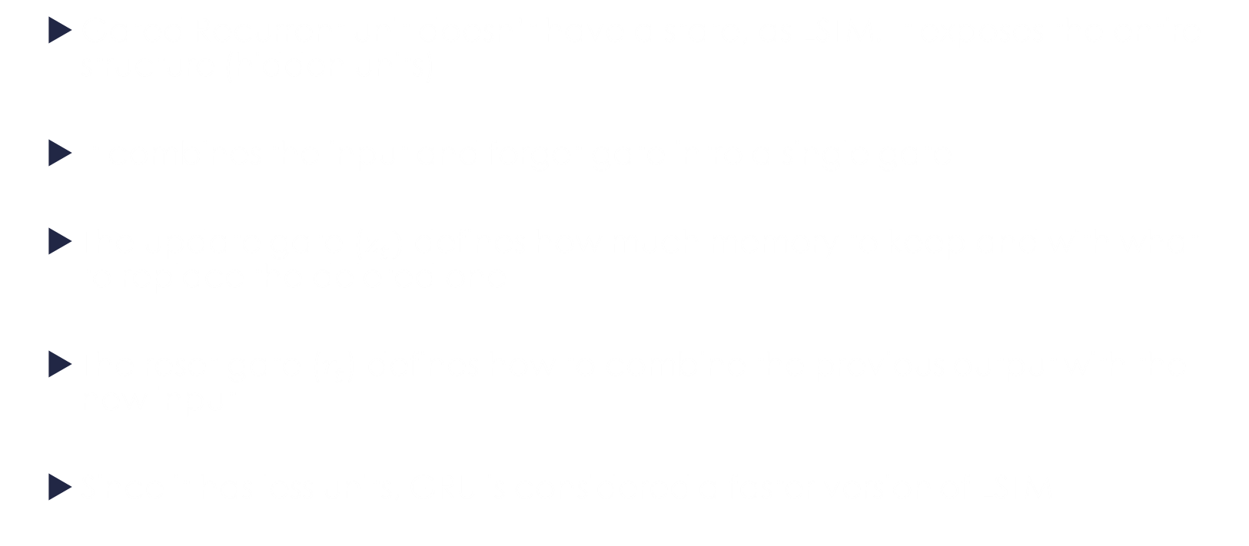
Variations of LSTM
Gated Recurrent unit doesn’t have a state, as LSTM. It exposes the entire structure (hidden units)
It combines the input and forget gate intro a single gate
The update gate ($z_{t})$ defines how much memory to keep and with what to replace the deleted one
The reset gate ($r_{t}$) defines how to combine the previous output with the new input
Since it has less units, GRU is considered a faster version of LSTM
Notes:
E usor pentru GRU sa repete ultimul output pe cand, pentru LSTM nu e asa usor
Fa o comparative intre portile de la gru si cele de la lstm
Gru nu are poarte de output si nici stare

Slide 72
LSTM in pytorch
Parameters
input_size – The number of expected features in the input x
hidden_size – The number of features in the hidden state h
num_layers – Number of recurrent layers. E.g., setting num_layers=2 would mean stacking two LSTMs together to form a stacked LSTM, with the second LSTM taking in outputs of the first LSTM and computing the final results. Default: 1
bias – If False, then the layer does not use bias weights b_ih and b_hh. Default: True
batch_first – If True, then the input and output tensors are provided as (batch, seq, feature) instead of (seq, batch, feature). Note that this does not apply to hidden or cell states. See the Inputs/Outputs sections below for details. Default: False
dropout – If non-zero, introduces a Dropout layer on the outputs of each LSTM layer except the last layer, with dropout probability equal to dropout. Default: 0
bidirectional – If True, becomes a bidirectional LSTM. Default: False
proj_size – If > 0, will use LSTM with projections of corresponding size. Default: 0
Notes:
Relu nu e bounded sus, deci explodeaza rpd

Slide 73
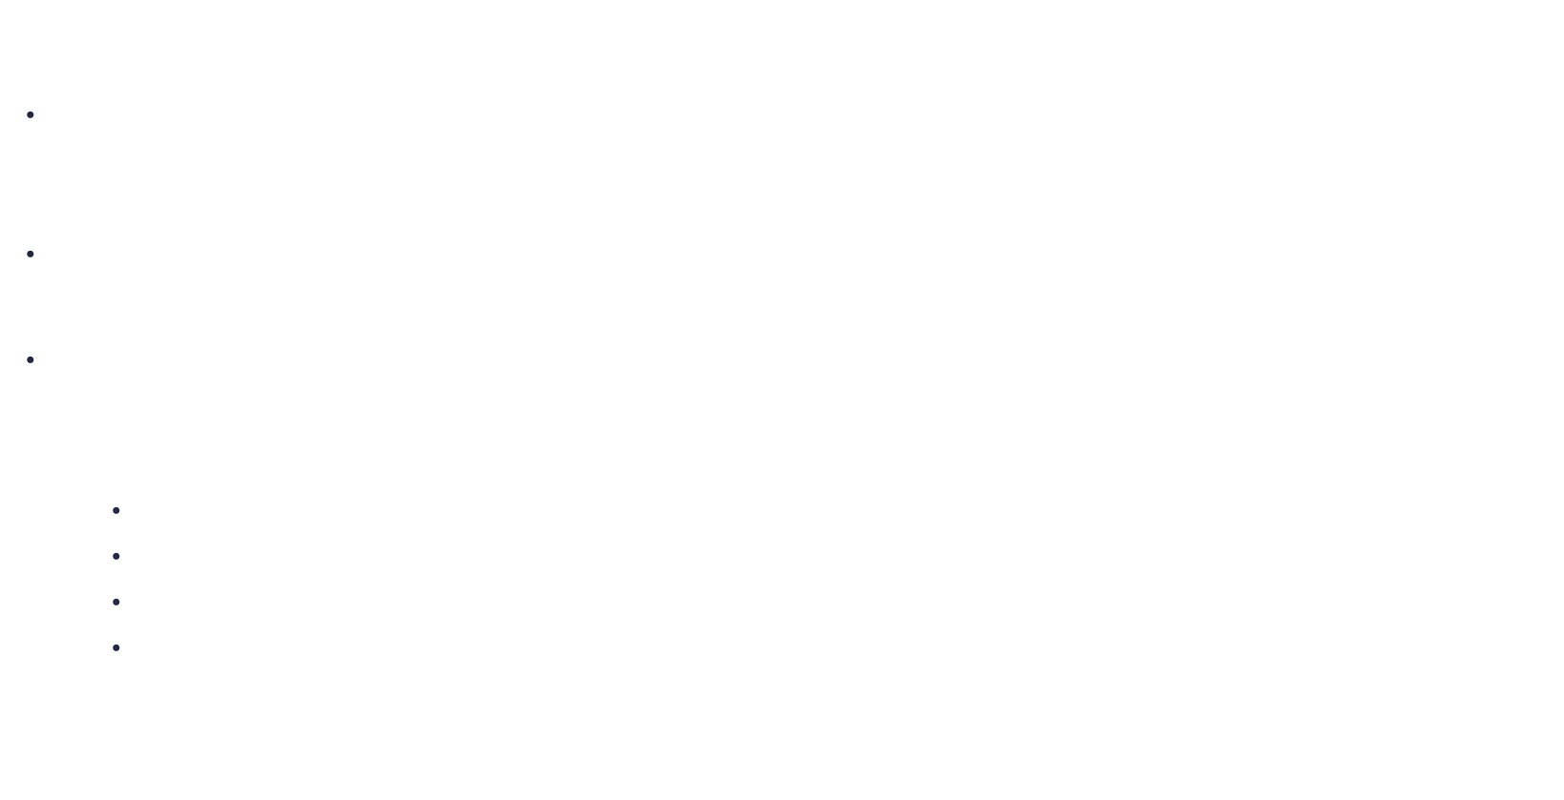
LSTM in pytorch
The Input for this tensor is a tuple ($input$, ${(h}_{0},c_{0}))$:
input: tensor of shape $\left(L, H_{in}\right)$for unbatched input, tensor of shape $\left(L, N, H_{in}\right)$ when batch_first=False or tensor of shape $\left(N, L, H_{in}\right)$ when batch_first=True
$h_{0}$: tensor of shape ($num_layers$, $H_{out}$) for unbached input, tensor of shape ($num_layers$, $N, { H}_{out}$) for batched input containing the initial hidden state
$c_{0}$: tensor of shape ($num_layers$, $H_{out}$) for unbached input, tensor of shape ($num_layers$, $N, { H}_{out}$) for batched input containing the initial cell state
where:
$L$ is the length of the sequence
$N$ is the size of the minibatch
$H_{in}$ is the hidden input size
$H_{out}$ is the hidden output size
It is the responsibility of the programmer to allocate memory for the hidden state, cell state and to initialize it with zeros
Notes:
Similar ca la RNN, dar de data asta am si valori pentru c

Slide 74
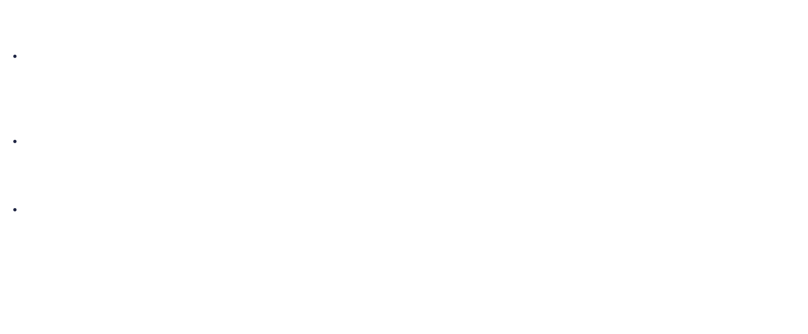
LSTM in pytorch
The Output for this tensor is a tuple ($output$, ${(h}_{n},c_{n}))$:
output: tensor of shape $\left(L, {1, H}_{out}\right)$for unbatched input, tensor of shape $\left(L, N, {1, H}_{out}\right)$ when batch_first=False or tensor of shape $\left(N, L, {1, H}_{out}\right)$ when batch_first=True containing the output from the last layer of the RNN at each timestep
$h_{n}$: tensor of shape ($num_layers$, $H_{out}$) for unbached input, tensor of shape ($num_layers$, $N, { H}_{out}$) for batched input containing the final hidden state for each element in the batch
$C_{n}$: tensor of shape ($num_layers$, $H_{out}$) for unbached input, tensor of shape ($num_layers$, $N, { H}_{out}$) for batched input containing the final cell state for each element in the batch
The programmer decides how to use the output at each time step. For example, use only the final output or use the outputs at each timestep
Notes:
$\left(L, {1, H}_{out}\right)$ pentru ca poti implementa si bidirectional, iar in cazul asta va fi 2 in loc de 1

Slide 75
LSTM in pytorch
class RNN_LSTM(nn.Module):
def __init__(self, input_size, hidden_size, num_layers, num_classes):
super(RNN_LSTM, self).__init__()
self.hidden_size = hidden_size
self.num_layers = num_layers
self.lstm = nn.LSTM (input_size, hidden_size, num_layers, batch_first=True)
self.fc = nn.Linear(hidden_size * sequence_length, num_classes)
Same as RNN, but use nn.LSTM instead of nn.RNN
Store the configuration.
Define the RNN layers:
the input size: the size of each element in the sequence 28 * hidden_size : the number of neurons in each hidden layer:256 * num_layers: the number of hidden layer: 2 * batch_first : the data will be in the following format (N, S, 28 ) = ( 64, 28, 28)
Add a hidden layer that connects the output at each time step to the an output layer .

Slide 76
LSTM in pytorch
class RNN_LSTM(nn.Module):
...
def forward(self, x):
# Set initial hidden and cell states
h0 = torch.zeros(self.num_layers, x.size(0), self.hidden_size).to(device)
c0 = torch.zeros(self.num_layers, x.size(0), self.hidden_size).to(device)
# Forward propagate LSTM
out, _ = self.lstm(x, (h0,c0))
out = out.reshape(out.shape[0], -1)
# Decode the hidden state of the last time step
out = self.fc(out)
return out
Initialize the hidden vector and the hidden state of each layer.
There must be one hidden vector per layer, per input in the minibatch. The size of each vector we’ve defined in the configuration

Slide 77
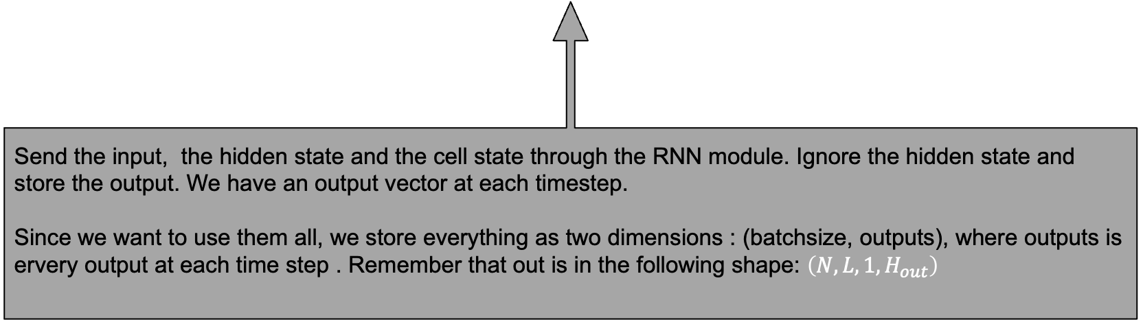
LSTM in pytorch
class RNN_LSTM(nn.Module):
...
def forward(self, x):
# Set initial hidden and cell states
h0 = torch.zeros(self.num_layers, x.size(0), self.hidden_size).to(device)
c0 = torch.zeros(self.num_layers, x.size(0), self.hidden_size).to(device)
# Forward propagate LSTM
out, _ = self.lstm(x, (h0,c0))
out = out.reshape(out.shape[0], -1)
# Decode the hidden state of the last time step
out = self.fc(out)
return out
Send the input, the hidden state and the cell state through the RNN module. Ignore the hidden state and store the output. We have an output vector at each timestep. Since we want to use them all, we store everything as two dimensions : (batchsize, outputs), where outputs is ervery output at each time step . Remember that out is in the following shape: $\left(N, L, {1, H}_{out}\right)$

Slide 78
LSTM in pytorch
class RNN_LSTM(nn.Module):
...
def forward(self, x):
# Set initial hidden and cell states
h0 = torch.zeros(self.num_layers, x.size(0), self.hidden_size).to(device)
c0 = torch.zeros(self.num_layers, x.size(0), self.hidden_size).to(device)
# Forward propagate LSTM
out, _ = self.lstm(x, (h0,c0))
out = out.reshape(out.shape[0], -1)
# Decode the hidden state of the last time step
out = self.fc(out)
return out
Connect all the outputs to a fully connected layer. The output of the fully connected layers is the classification of the input

Slide 79
LSTM in pytorch
Results from training using a LSM:
100%|██████████████████████████████████████████████████| 938/938 [00:18<00:00, 51.76it/s]
100%|██████████████████████████████████████████████████| 938/938 [00:18<00:00, 51.47it/s]
100%|██████████████████████████████████████████████████| 938/938 [00:17<00:00, 52.13it/s]
100%|██████████████████████████████████████████████████| 938/938 [00:17<00:00, 52.18it/s]
100%|██████████████████████████████████████████████████| 938/938 [00:18<00:00, 52.11it/s]
100%|██████████████████████████████████████████████████| 938/938 [00:17<00:00, 52.14it/s]
100%|██████████████████████████████████████████████████| 938/938 [00:18<00:00, 52.00it/s]
100%|██████████████████████████████████████████████████| 938/938 [00:18<00:00, 51.97it/s]
100%|██████████████████████████████████████████████████| 938/938 [00:18<00:00, 51.90it/s]
100%|██████████████████████████████████████████████████| 938/938 [00:17<00:00, 53.87it/s]
Accuracy on training set: 99.459999
Accuracy on test set: 98.76

Slide 80
GRU in pytorch
Parameters input_size – The number of expected features in the input x
hidden_size – The number of features in the hidden state h
num_layers – Number of recurrent layers. E.g., setting num_layers=2 would mean stacking two GRUs together to form a stacked GRU, with the second GRU taking in outputs of the first GRU and computing the final results. Default: 1
bias – If False, then the layer does not use bias weights b_ih and b_hh. Default: True
batch_first – If True, then the input and output tensors are provided as (batch, seq, feature) instead of (seq, batch, feature). Note that this does not apply to hidden or cell states. See the Inputs/Outputs sections below for details. Default: False
dropout – If non-zero, introduces a Dropout layer on the outputs of each GRU layer except the last layer, with dropout probability equal to dropout. Default: 0
bidirectional – If True, becomes a bidirectional GRU. Default: False
Notes:
Relu nu e bounded sus, deci explodeaza rpd

Slide 81
GRU in pytorch
Training a GRU is straight forward. Just replace nn.RNN with nn.GRU
100%|██████████████████████████████████████████████████| 938/938 [00:17<00:00, 54.74it/s]
100%|██████████████████████████████████████████████████| 938/938 [00:17<00:00, 54.74it/s]
100%|██████████████████████████████████████████████████| 938/938 [00:17<00:00, 54.51it/s]
100%|██████████████████████████████████████████████████| 938/938 [00:17<00:00, 53.36it/s]
100%|██████████████████████████████████████████████████| 938/938 [00:14<00:00, 62.68it/s]
100%|██████████████████████████████████████████████████| 938/938 [00:06<00:00, 140.77it/s]
100%|██████████████████████████████████████████████████| 938/938 [00:16<00:00, 55.26it/s]
100%|██████████████████████████████████████████████████| 938/938 [00:17<00:00, 54.89it/s]
100%|██████████████████████████████████████████████████| 938/938 [00:17<00:00, 55.07it/s]
100%|██████████████████████████████████████████████████| 938/938 [00:17<00:00, 54.59it/s]
Accuracy on training set: 98.199997
Accuracy on test set: 97.84

Slide 82
Questions & Discussion

Slide 83
Bibliography
http://colah.github.io/posts/2015-08-Understanding-LSTMs/
(lstm overview. Good to read it first)
http://harinisuresh.com/2016/10/09/lstms/
http://www.wildml.com/2015/09/recurrent-neural-networks-tutorial-part-1-introduction-to-rnns/
http://arunmallya.github.io/writeups/nn/lstm/index.html#/12
(derivatives for lstm)
http://willwolf.io/2016/10/18/recurrent-neural-network-gradients-and-lessons-learned-therein/ (derivatives for lstm)
https://ayearofai.com/rohan-lenny-3-recurrent-neural-networks-10300100899b (lstm very well explained. Most of this class is based on information found here)
https://medium.com/mlreview/understanding-lstm-and-its-diagrams-37e2f46f1714 (well designed graphics)
https://r2rt.com/written-memories-understanding-deriving-and-extending-the-lstm.html#written-memories-the-intuition-behind-lstms
http://karpathy.github.io/2015/05/21/rnn-effectiveness/
(nice and easy to follow examples of lstm on text generation)

